Slide 1

CS483 Digital Forensics
Windows Internals III

Slide 2
Learning Objectives
PE32 File Structure

Slide 3
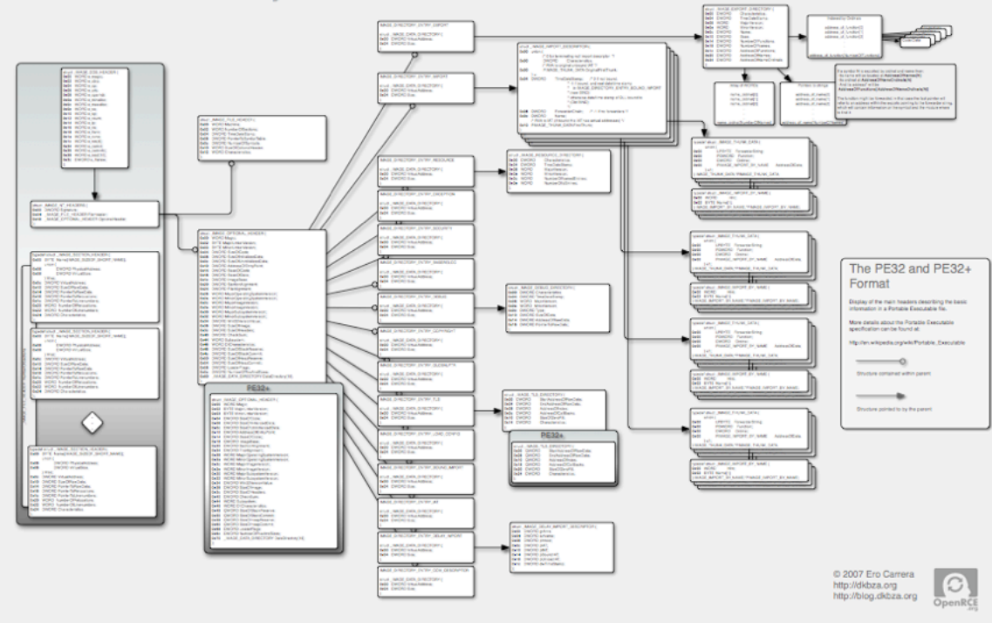
PE32 Internals
Notes:
One of the most important (and complex) file format structures for a malware analyst to study is the PE32 file format (PE32+ for 64-bit binaries).

Slide 4
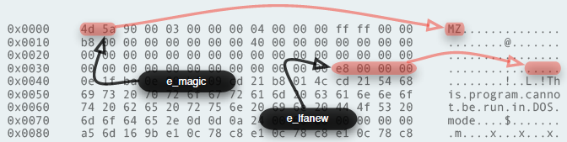
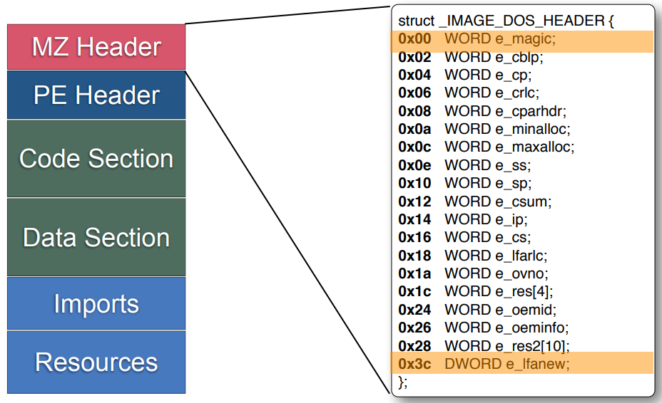
MZ/DOS Header
Notes:
The DOS header can be found starting at offset zero in all Portable Executable
files. Nowadays its main objective is to indicate the offset of the main headers
containing the actual information about the PE file, the NT headers. The offset
where to find those headers is stored in the e_lfanew member.

Slide 5
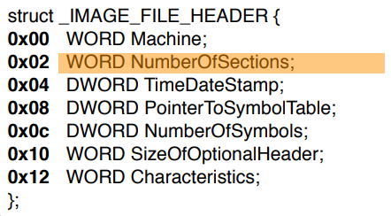
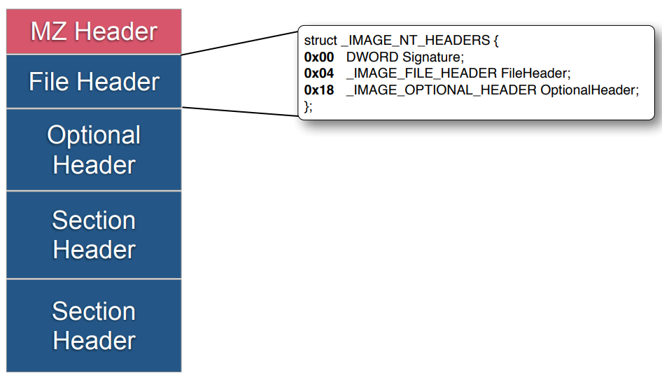
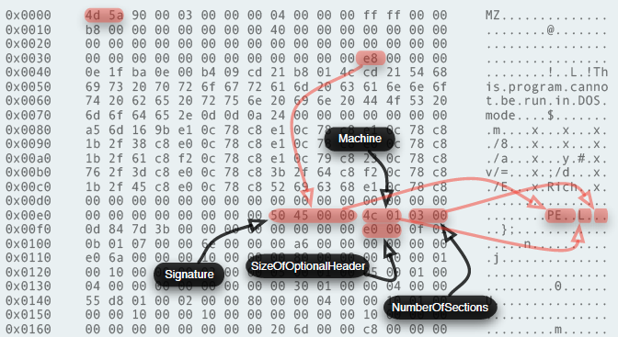
NT Header / File Header
Notes:
The NT headers contain three members, a signature and two other structures
defining the File header and the Optional header. The signature is the
standard doubleword 0x50450000 with ASCII representation "PE". Some of the
important members of the File header are Machine, specifying the target
architecture for which this PE file is compiled, and the self-describing
SizeOfOptionalHeader and NumberOfSections.

Slide 6
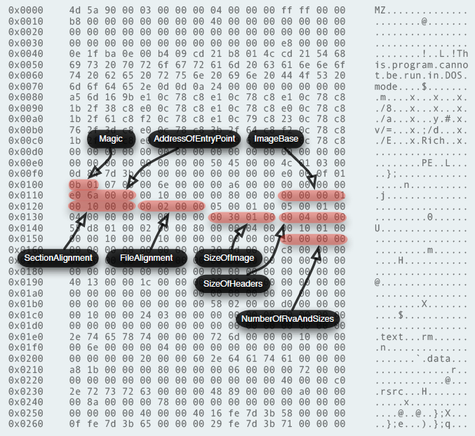
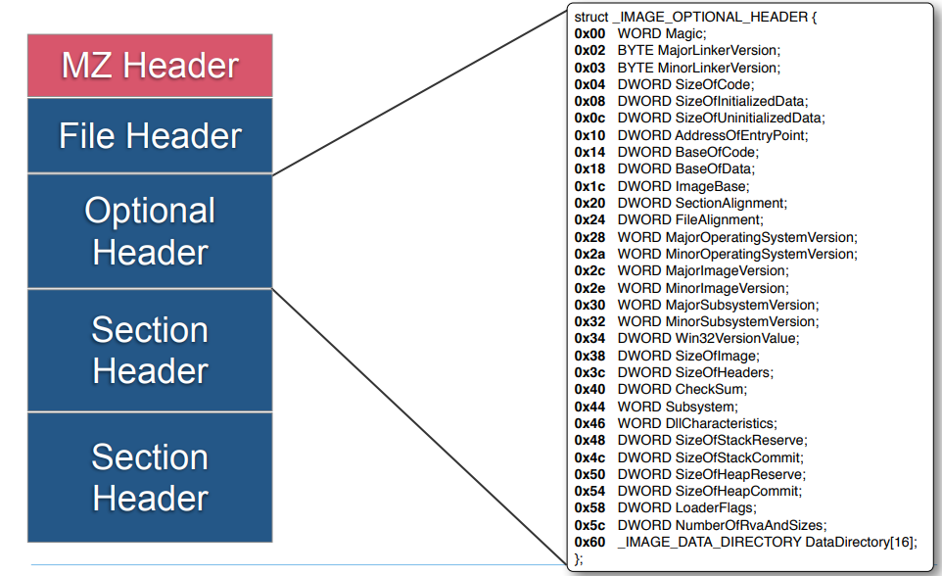
Optional Header
Notes:
The Optional header member describes elements of the file such as the import
and export directories that make possible to locate and link DLL libraries (which
are PE files as well). Other entries provide structural information about the
layout of the file, such as the alignment of its sections.

Slide 7
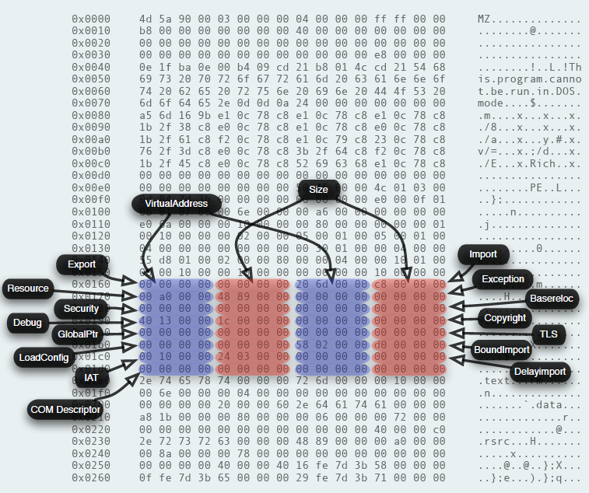
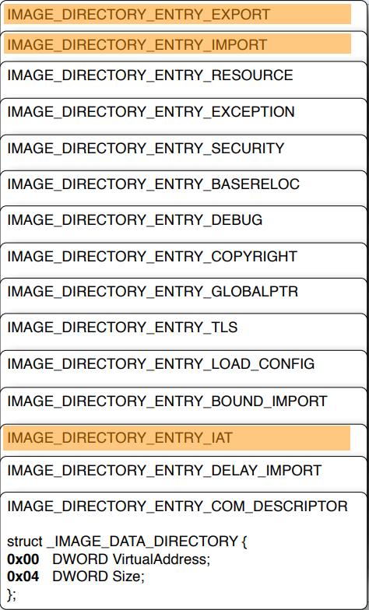
Data Directories
Notes:
These entries, contained within the Optional header, point to a wide selection
of miscellaneous information about the file. Imported and exported symbols,
debug information, resource information (icon data, version information) and
others.
All of these are optional, but few PE files go without having a symbol import or
export table that would allow them to link to (or have its symbols used by) other
PE files.

Slide 8
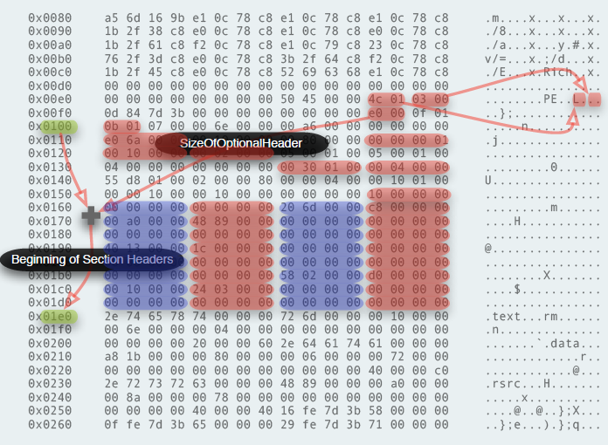
Locating Section Headers
Notes:
The Section headers follow immediately after the Optional header. The
procedure to find their starting offset is to add the value from the File header
member SizeOfOptionalHeader to the starting offset of the Optional header.
The resulting value will point to the first section header. The number of sections
is specified by the field NumberOfSections in the File header.

Slide 9
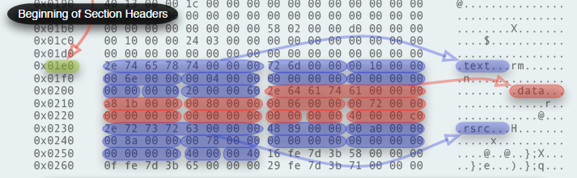
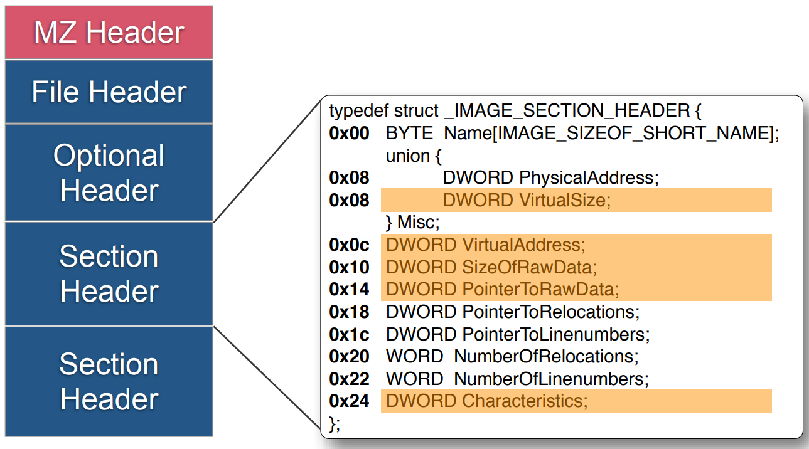
Section Headers
Notes:
The Section headers describe each of the sections making up the file. Sections
can contain code (often referred to as text, hence the common section name
'.text'), initialized and uninitialized data, more information describing the PE file
itself such as resources or any other data the developer wishes to add.
There can be an arbitrary number of sections in a PE file.

Slide 10
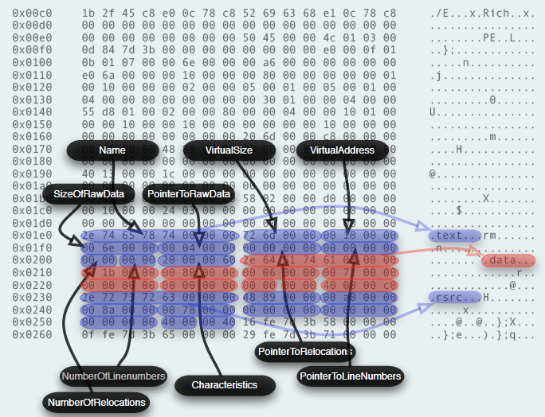
Section Headers
Notes:
Each Section header structure contains the details needed to find it within the
file (PointerToRawData), its size on disk (SizeOfRawData) and once loaded
(VirtualSize) and where to load it in memory (VirtualAddress) relative to the
Optional header field ImageBase. Whether the section contains executable
code, can be read from, written to or has other properties is specified by the
Characteristics field.

Slide 11
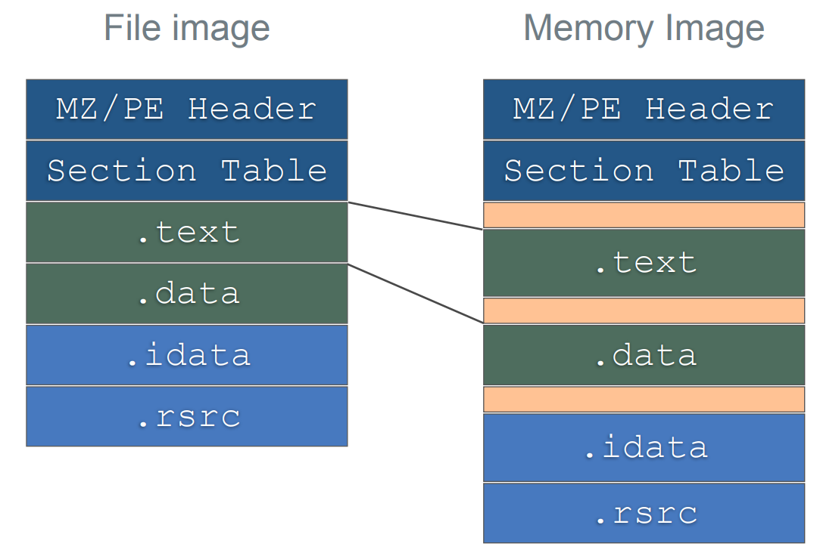
PE Image File Loading
Notes:
Question for class: When the PE image file is loaded, why is extra slack space created between the sections?

Slide 12
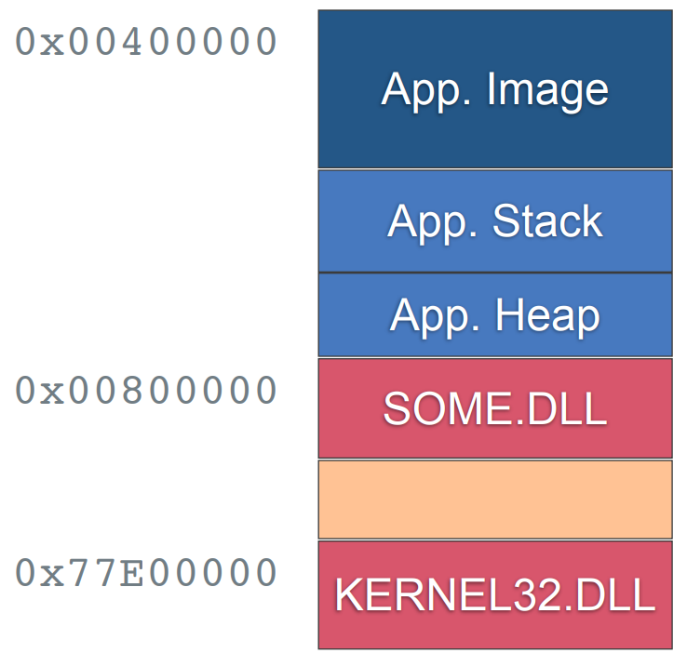
Memory Layout
Notes:
Question for class: When the PE image file is loaded, why is extra slack space created between the sections?

Slide 13
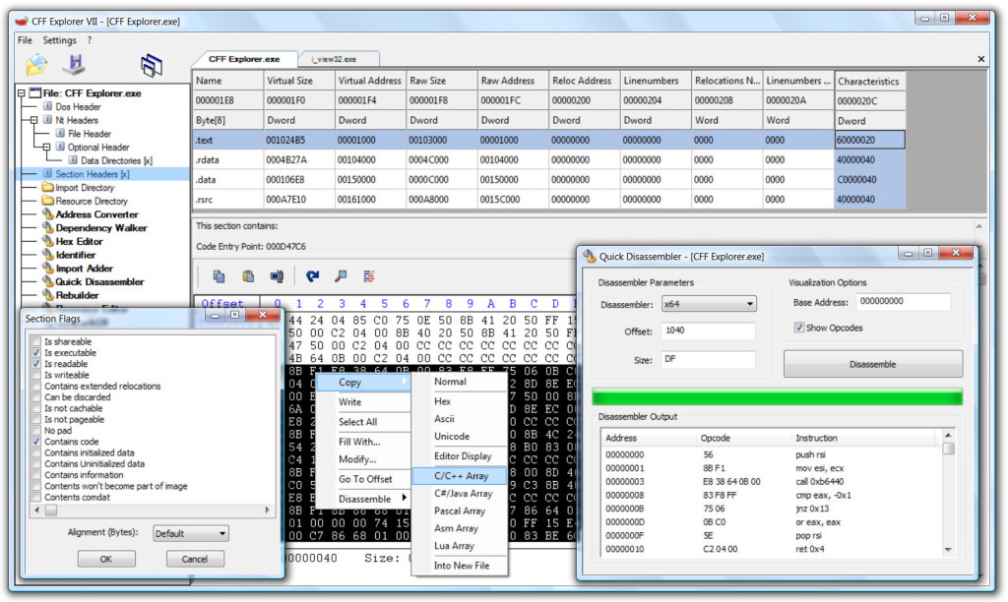
CFF Explorer – Parse and Explore PE32

Slide 14
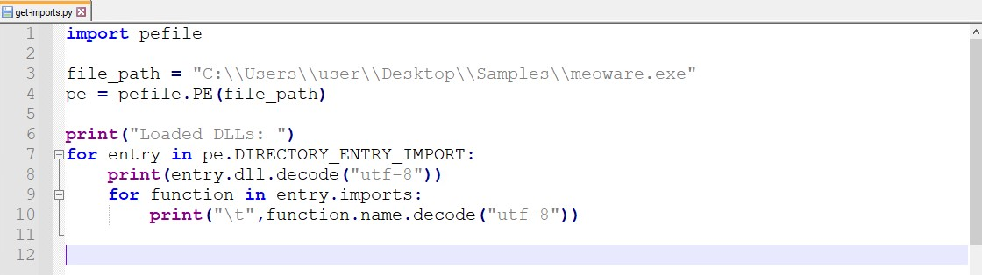
Python pefile Library
Example: Extract Imports programmatically:

Slide 15
Summary
Perform rapid malware triage
Utilize simple static and dynamic techniques to analyze Windows PE32 files
Develop simple tools for automated feature extraction

Slide 16
If You Remember 4 Things…
Everything is a data structure.
It’s all code. Not magic.
Abstraction leaves gaps.
Own your tools.

Slide 17

For Next Lesson
Read Chapters 1-3 from Practical Malware Analysis

